Slide 1
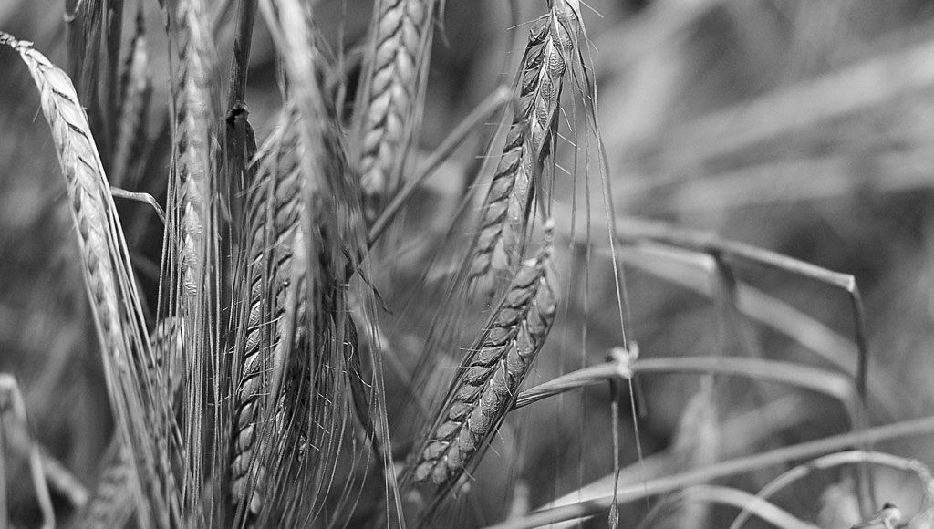
G-BHARAT
TEAM:SnapDragon
Neha Prince
Nidhish P P
Sanoop Devassia
Alex John
Alex K J
Melvin Moncy

Slide 2
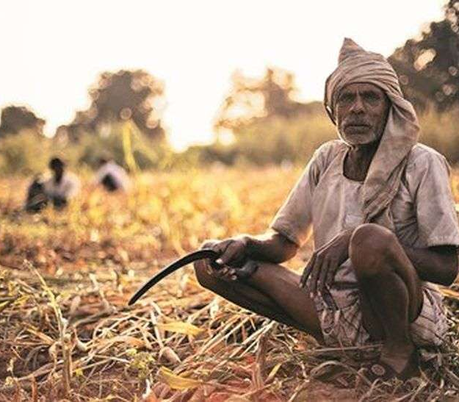
PROBLEM STATEMENT
Crop Failures
Decreasing Farmers
Increase in use of Chemicals and pesticides in agriculture
Climate change

Slide 3

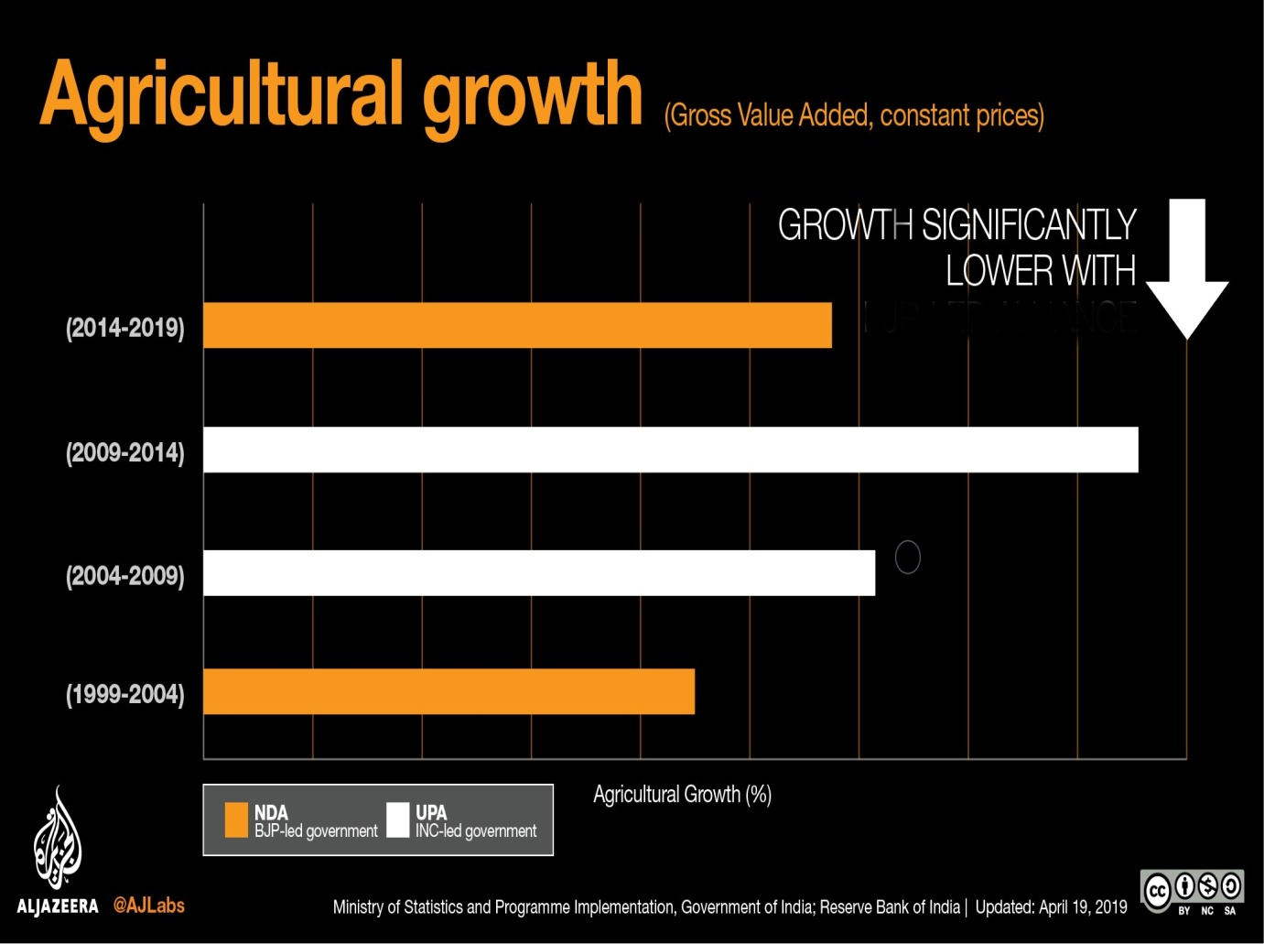
STATISTICS

Slide 4

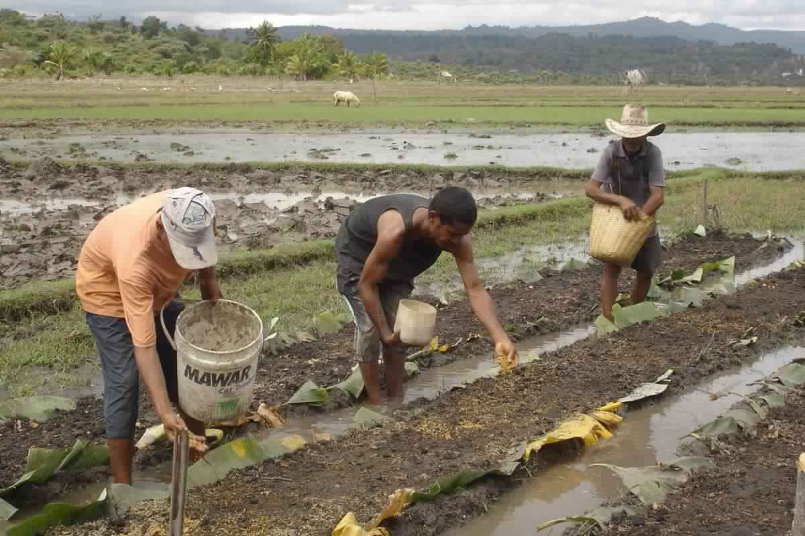

SOLUTION
G-BHARAT
AIM
FEATURES
“Let Bharat Grow”
A platform for farmers to share different farming techniques, their grievances, etc for efficient farming.
Farmers can share their unique farming ideas/organic techniques, register complaints/grievances,
get policy updates

Slide 5

BUSINESS MODEL
Financial Benefits
Customer Satisfaction
Cost Versus Benefits
1
2
3
Advertisements
Page Hits
Future: can be used as E-commerce platform
Meant as a service.
Farmers can make profits with increased productivity.
Grievances would be acknowledged immediately.
Cost: Hosting and Maintenance
Benefits: Social, economic, Financial

Slide 6
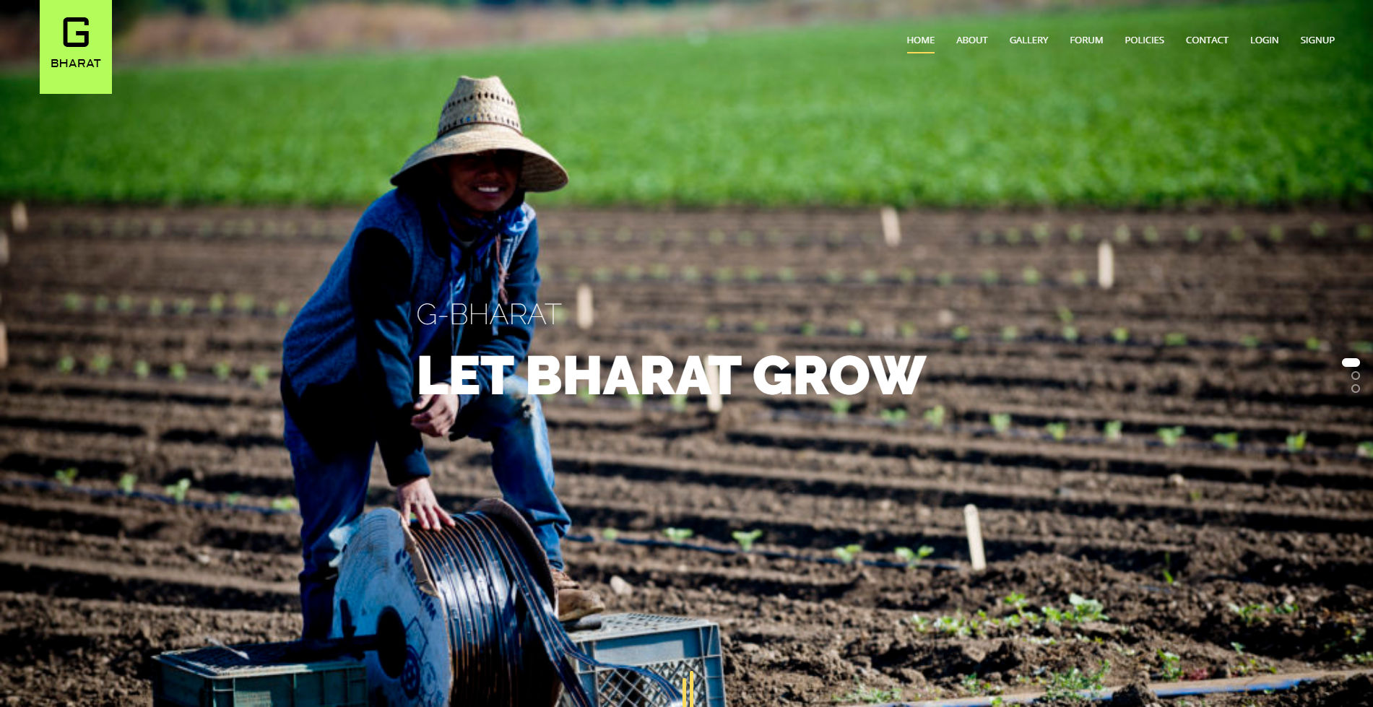
PROTOTYPE

Slide 7

THANK YOU!!

